Slide 1

CIT83104: ADVANCED WEB DESIGN AND DEVELOPMENT
By:
Mr. MANIRARORA Jean Marie Vianney
Course Code: CIT83104 & Name: ADVANCED WEB DESIGN AND DEVELOPMENT
1

Slide 2
CLASS INSTRUCTIONS
Please keep your phones aside during class sessions.
100% attendance is required for all classes.
Students are expected to practice effective time management.
Participation in all academic activities is mandatory, including:
Quizzes
In-class activities
Individual assignments
Group assignments
Presentations
Note: Failure to attend or participate in these activities may affect your overall performance.

Slide 3
MODULE OVERVIEW
Module Code: CIT83104
Title: Advanced Web Design and Development
Credits: 15
Year: 3rd Year
Prerequisite: Introduction to Web Design and Development
Total Study Hours: 150 (Lectures, Labs, Assignments, Self-study, etc.)

Slide 4
MODULE AIMS
Prepare students for professional web development
Blend theoretical knowledge with practical implementation
Focus on interactive, database-backed, and maintainable web applications

Slide 5
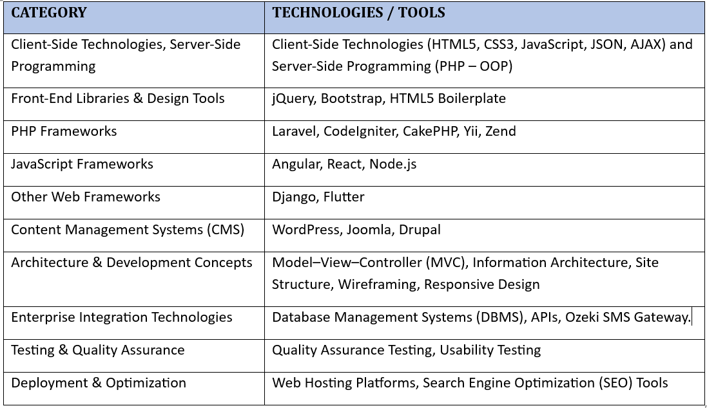
KEY TECHNOLOGIES & TOOLS

Slide 6
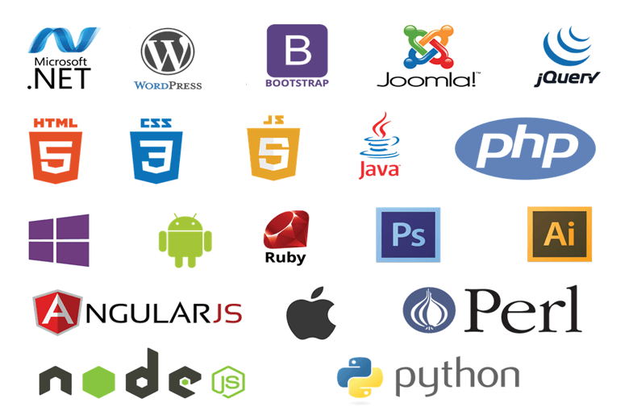

Slide 7
MODULE CONTENTS
HTML, CSS, JavaScript, layout techniques, and other industry-standard practices.
Scripting technologies to create dynamic and interactive websites.
Back-end interactivity with front-end to build web applications
Professional quality portfolio of web design work.
build Dynamic websites utilizing the most current versions of industry-standard applications and tools

Slide 8
CHAP 5: Build Dynamic Websites Utilizing The Most Current Versions Of Industry-standard Applications And Tools

Slide 9


Slide 10
ReactJS: ReactJS is an open-source popular JavaScript library for building interactive User
Interface (UI), especially single-page applications (SPAs). It focuses on creating reusable
components and uses a virtual DOM for optimized performance.
1. Introduction to REACT JS
What is React.js?
React.js is a JavaScript library developed by Facebook for building interactive UIs.
It focuses on the view layer in the MVC architecture.
React uses a component-based architecture and a virtual DOM for efficient rendering.

Slide 11
Category: Library (often considered a framework)
Developed by: Facebook
Features:
Component-based architecture
Supports JSX (JavaScript XML)
Excellent performance with Virtual DOM
Extensive ecosystem with tools like React Router, Redux
Use Cases: Web applications, dynamic UIs, large-scale applications.
Official Site: reactjs.org

Slide 12
Quick Checklist Before Running React
Installed Node.js (v16+) and npm/yarn.
Comfortable with HTML, CSS, and JavaScript ES6.
Basic understanding of JSX and components.
Ready to use Create React App or Vite for project setup.

Slide 13
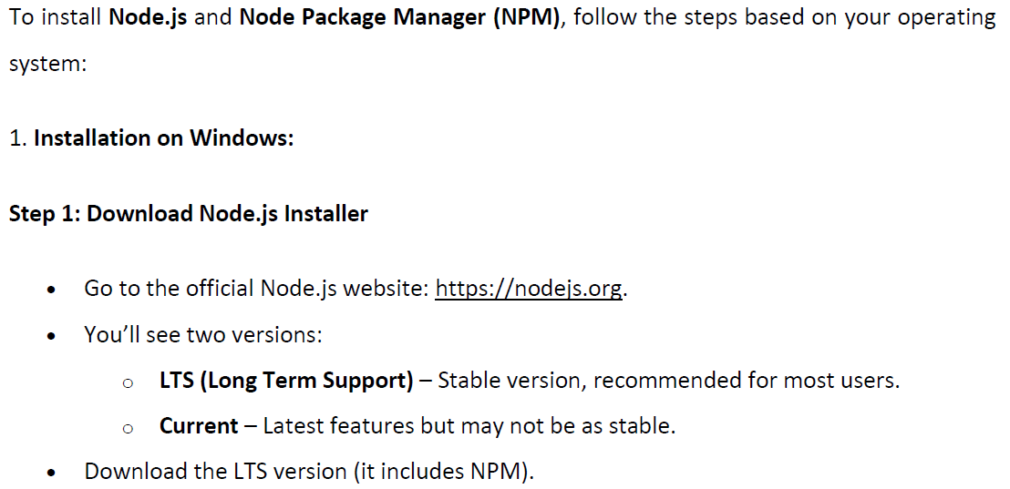
Installation of NodeJS and Node Package Manager (NPM)

Slide 14
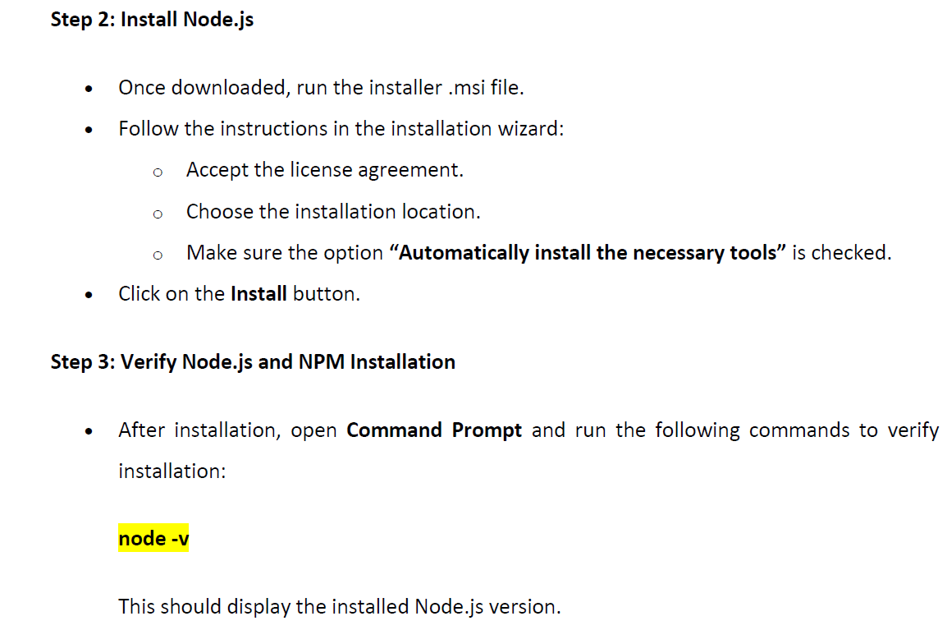

Slide 15
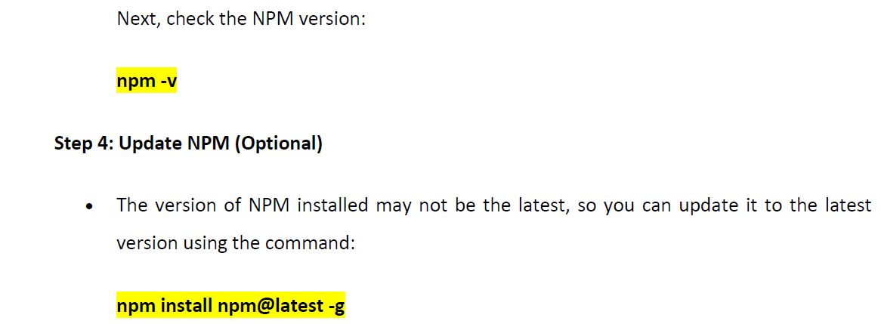

Slide 16
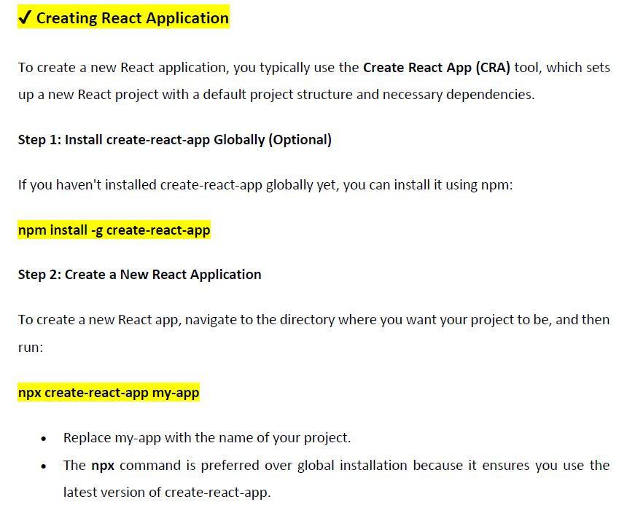

Slide 17
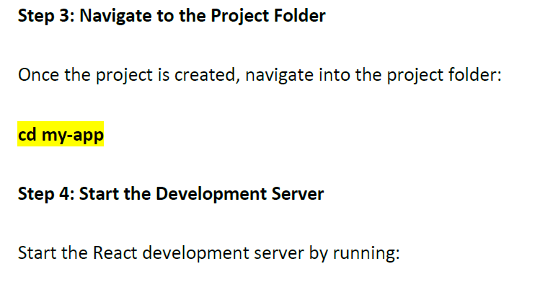


Slide 18
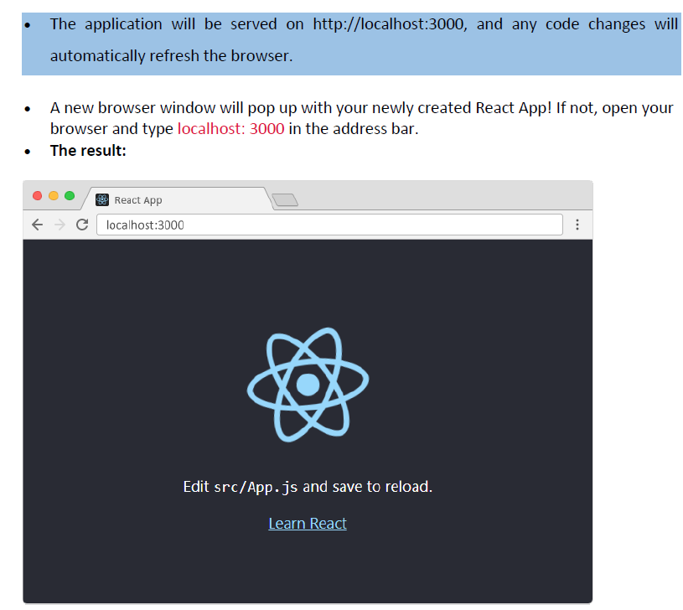

Slide 19
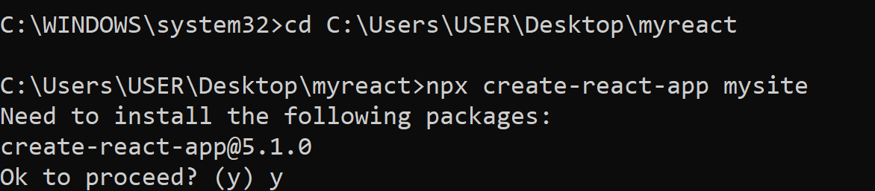
A very simple example:
Open Command Prompt (cmd.exe).
Go to the folder where you want to create the React project:
cd C:\Users\USER\Desktop\myreact
Create the project:
npx create-react-app mysite
This will create a folder named mysite inside C:\Users\USER\Desktop\myreact.
You will not encounter any PowerShell script errors.
Enter the project folder and start the development server:
cd mysite npm start
Your browser will open at http://localhost:3000.

Slide 20
Notes:
npx stands for Node Package Execute.
It is a package runner tool that comes bundled with npm (Node Package Manager) starting from version 5.2.0 and above.
Its job is to execute Node.js packages directly without needing to install them globally.

Slide 21
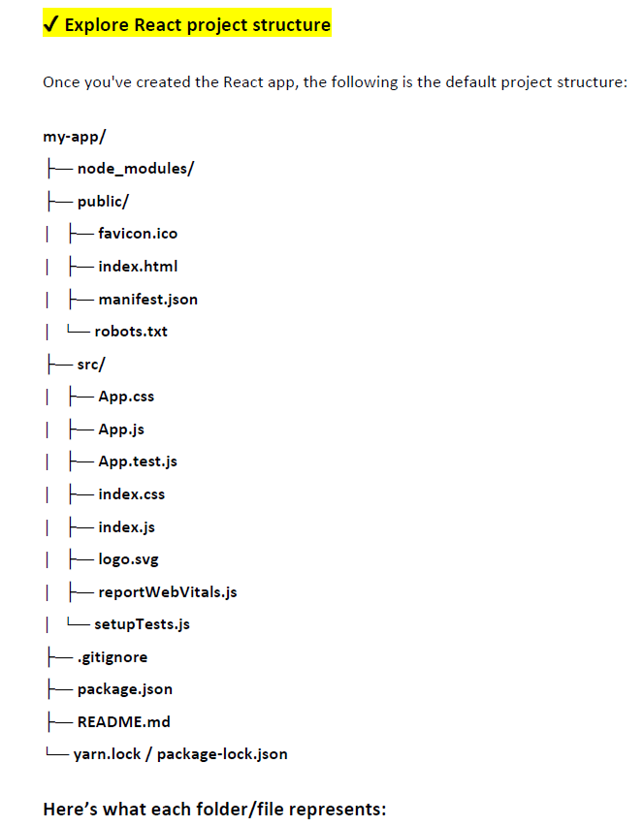

Slide 22
Here’s what each folder/file represents:
1. node_modules/
Contains all the project dependencies installed via npm or yarn.

Slide 23
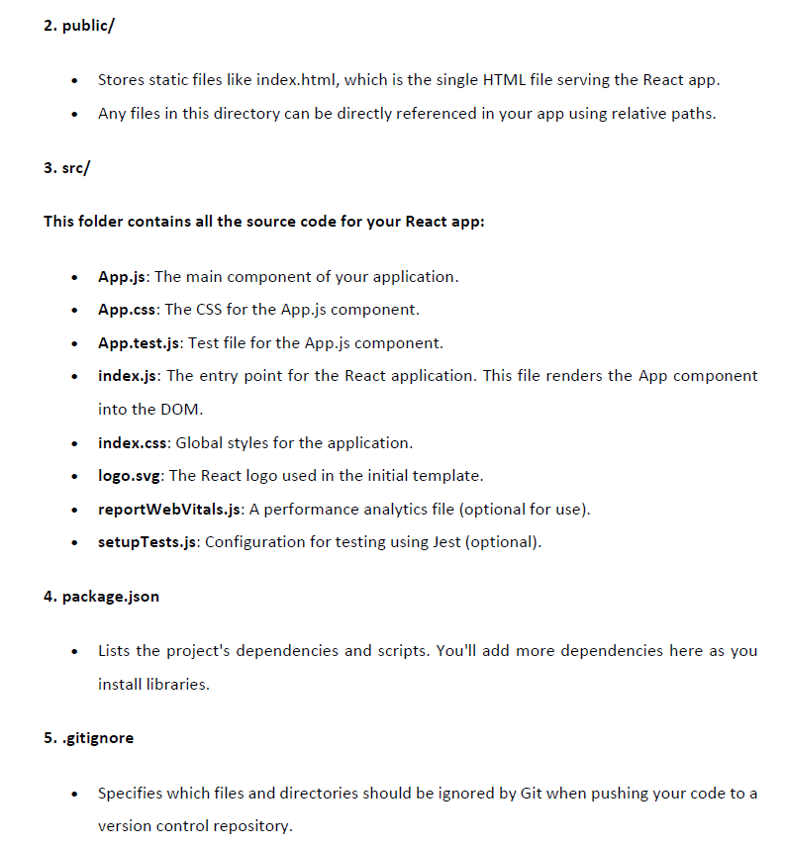

Slide 24
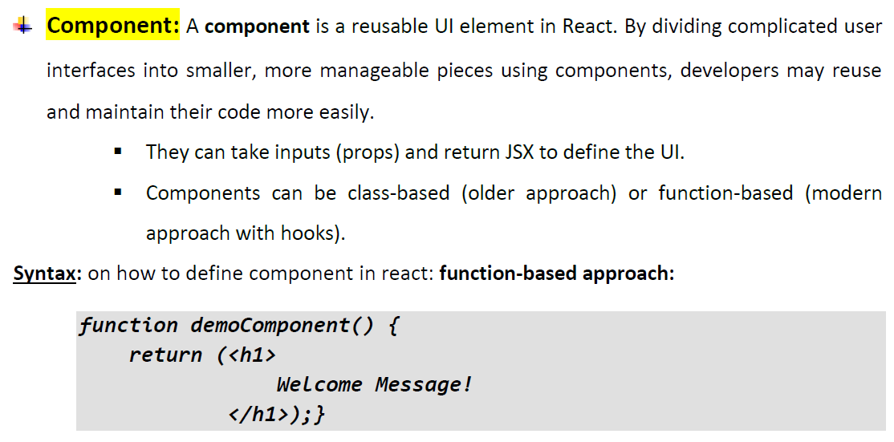
2. Definition of key concepts

Slide 25
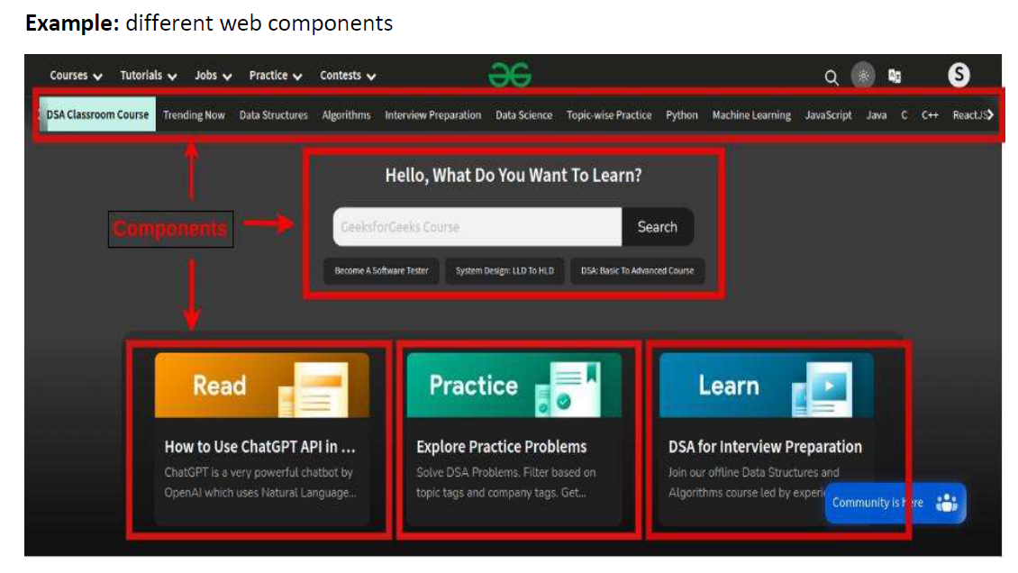

Slide 26
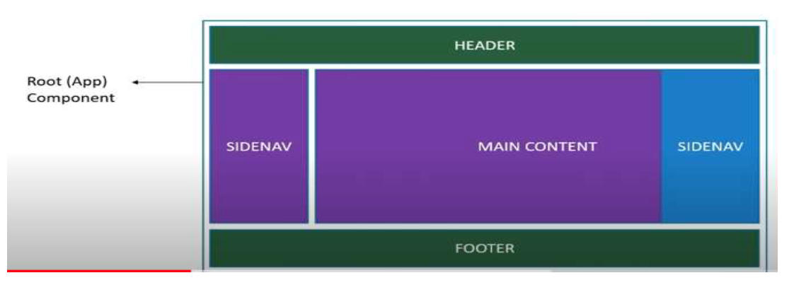

Slide 27
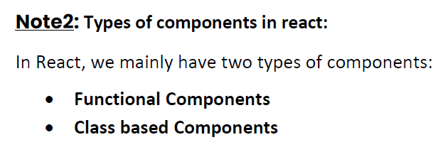
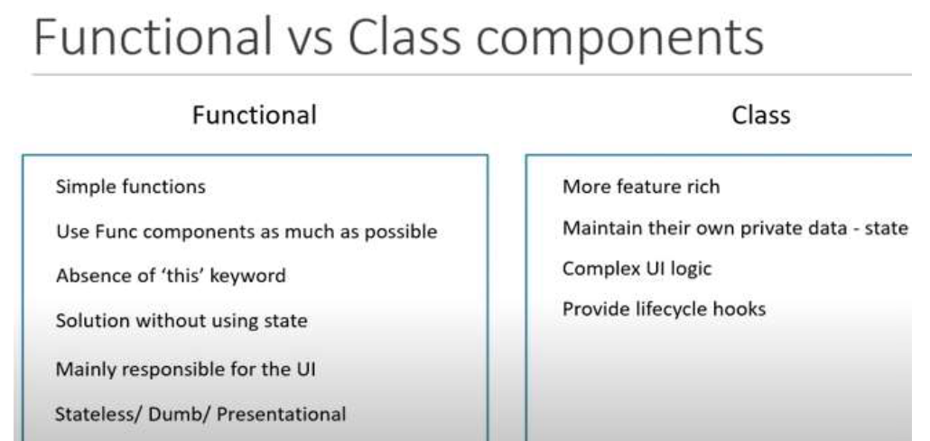

Slide 28
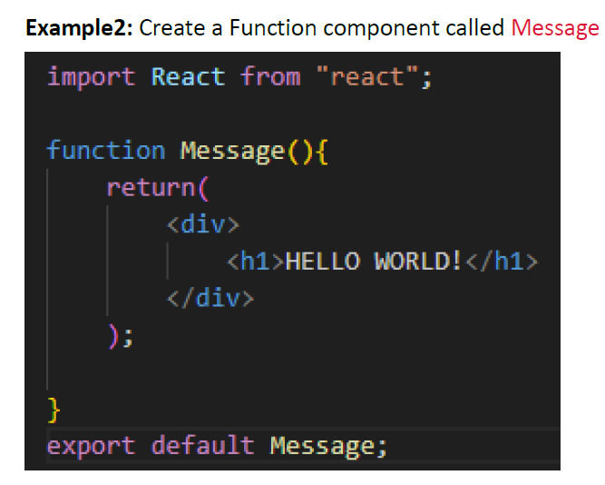

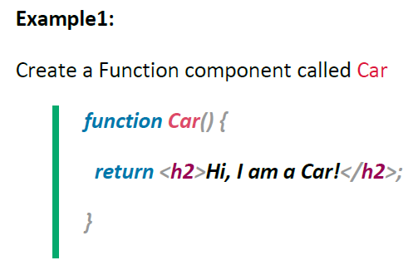

Slide 29
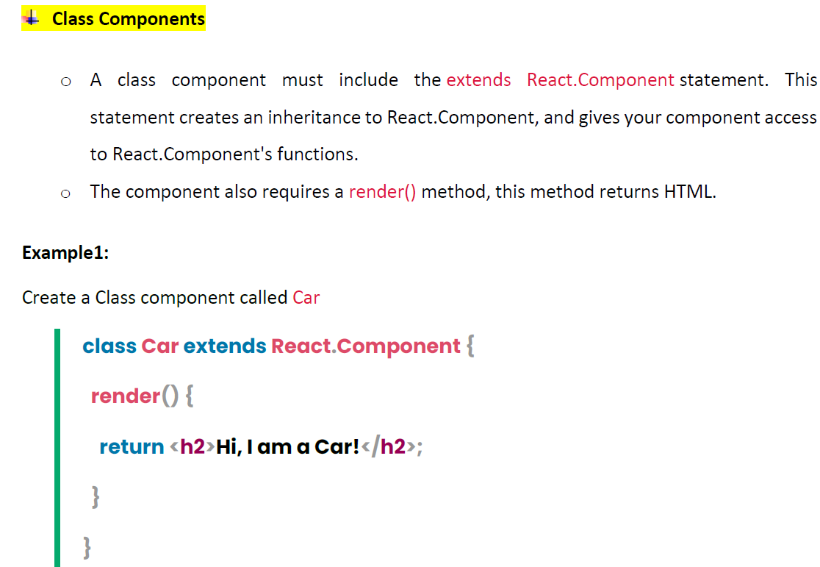

Slide 30
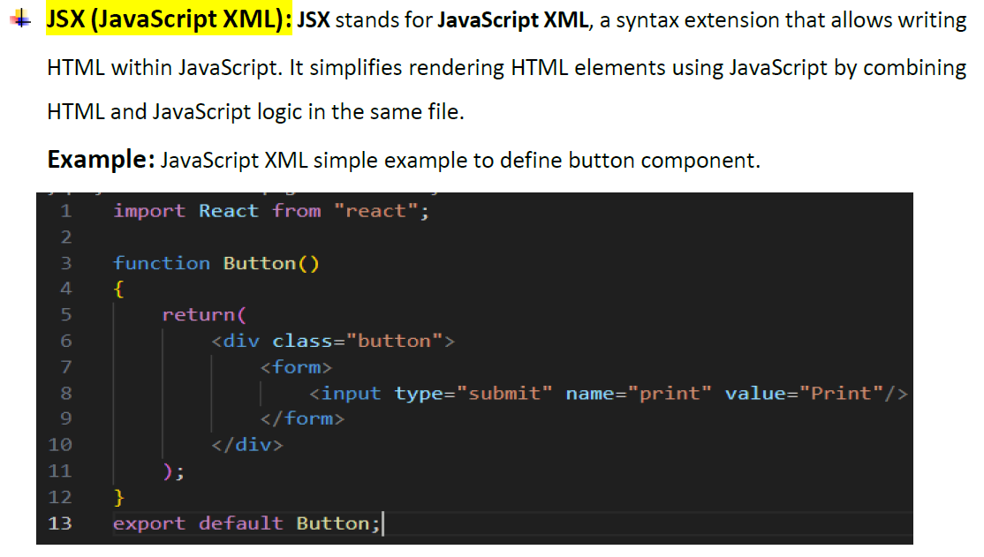

Slide 31
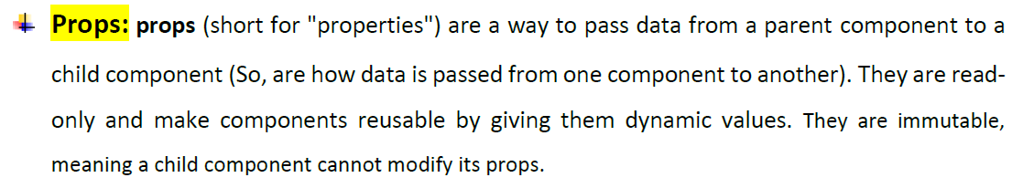

Slide 32
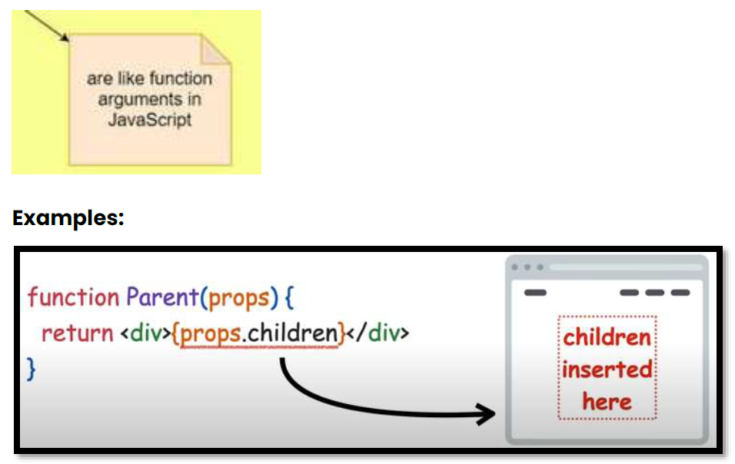

Slide 33
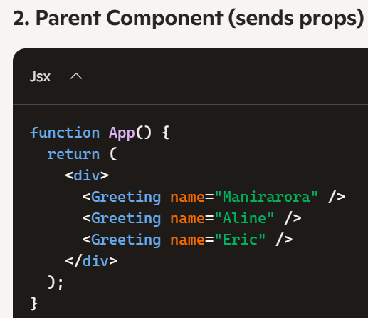
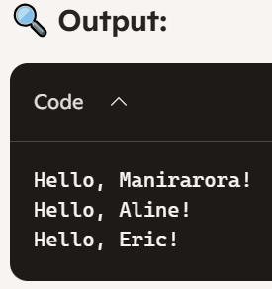
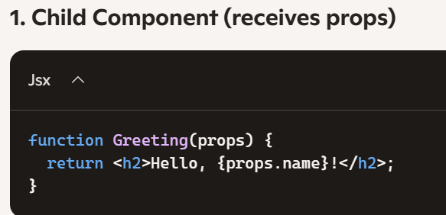

Slide 34
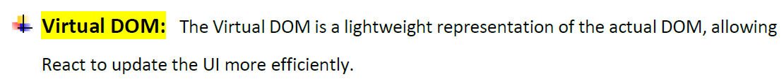

Slide 35
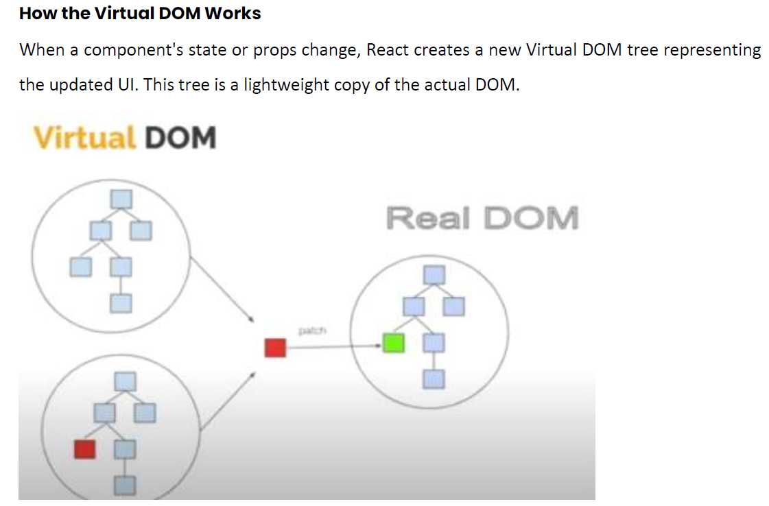

Slide 36
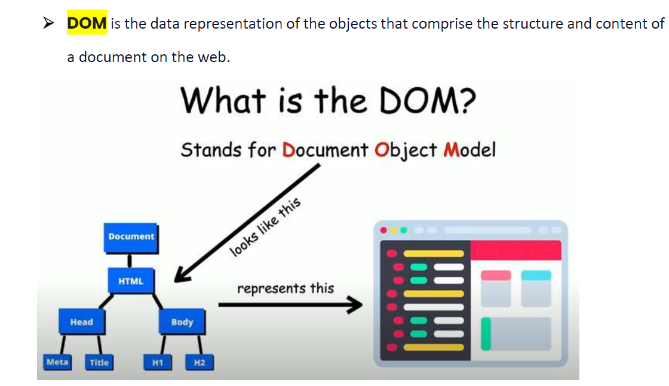

Slide 37
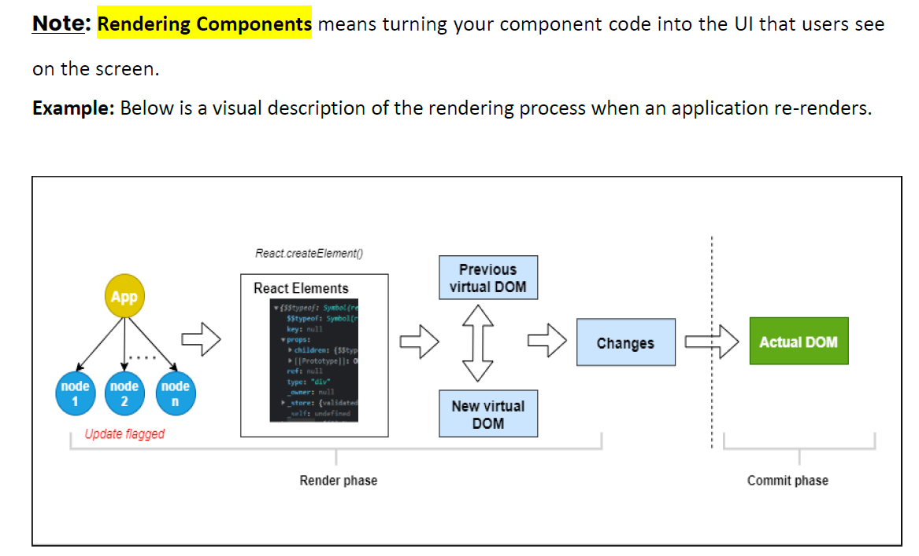

Slide 38
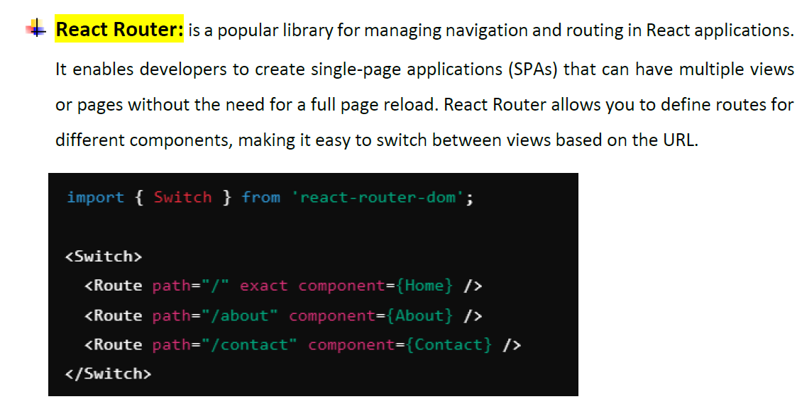

Slide 39
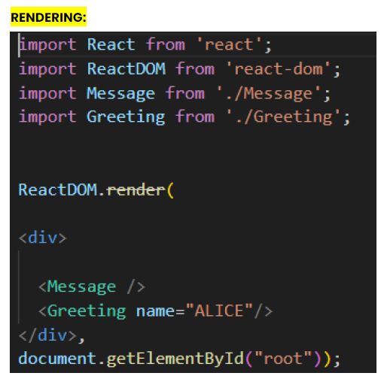
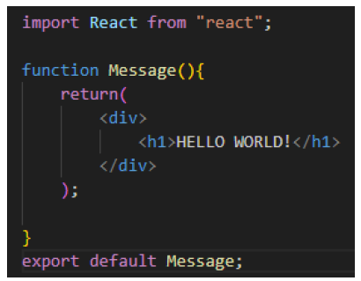
Rendering a component
Create a Function component called Message

Slide 40
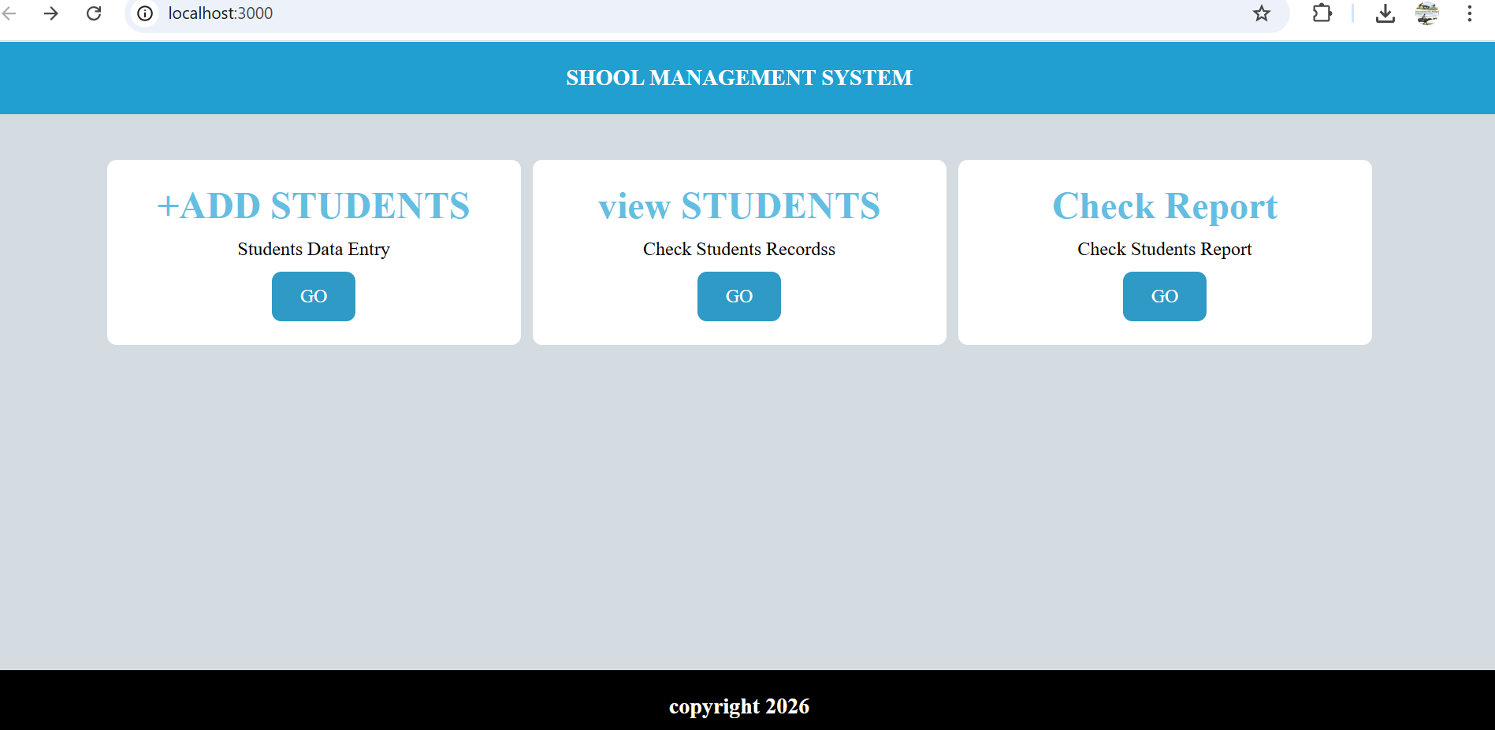
Examples: let us design this simple interface using function-based components in react js

Slide 41
Notes:
Our simple website consists of three main components: Header, Footer, and Content.
To keep the structure simple and organized, you should create three separate JavaScript files (functions) for these components, as demonstrated in the src folder as shown below:

Slide 42
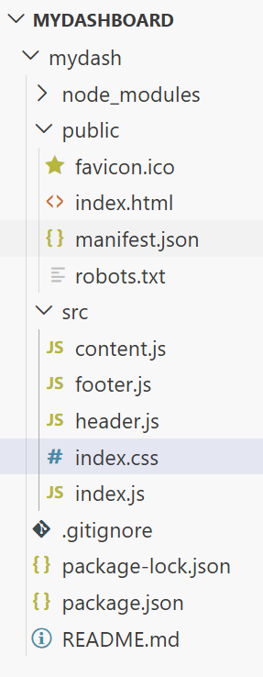
This diagram illustrates how the project files are organized in a folder using VS Code as the text editor. >>>>>>>>>>

Slide 43
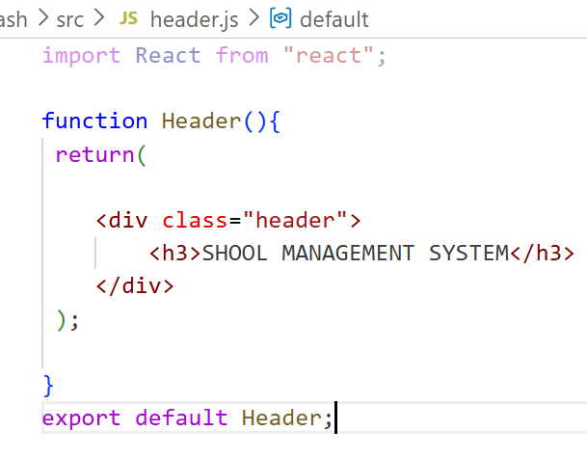
heaher.js >>>>>>>>>>

Slide 44
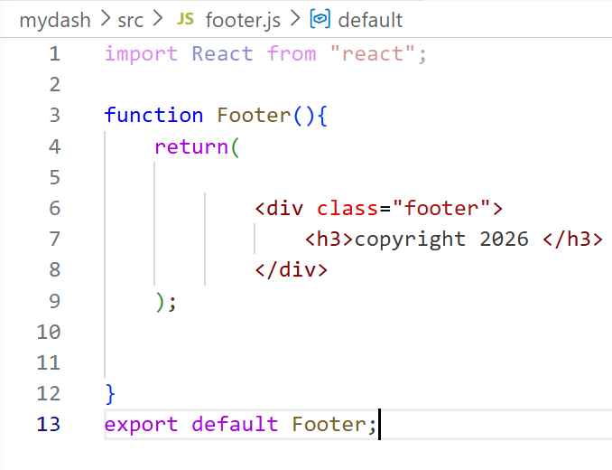
footer.js >>>>>>>>>>

Slide 45
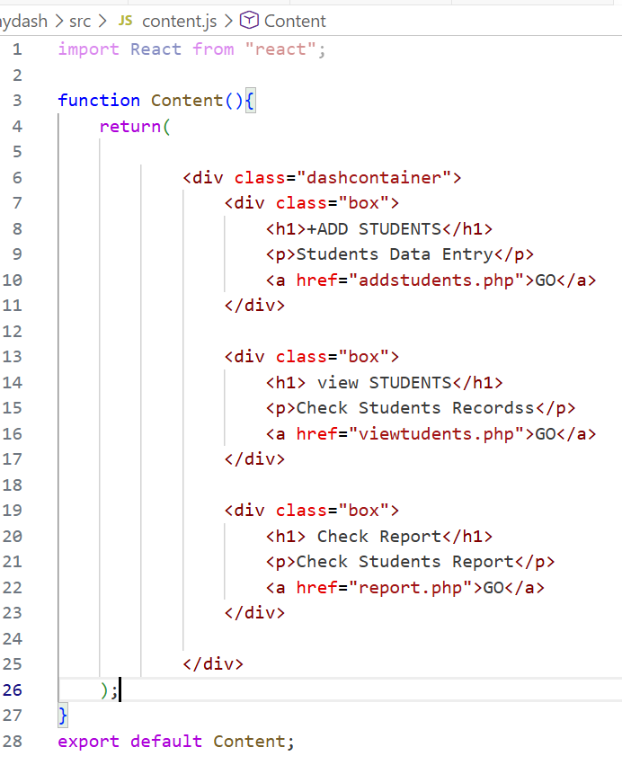
content.js >>>>>>>>>>

Slide 46
Note:
CSS styles should be applied in the >>> index.css file to control the appearance of the website as shown below:

Slide 47
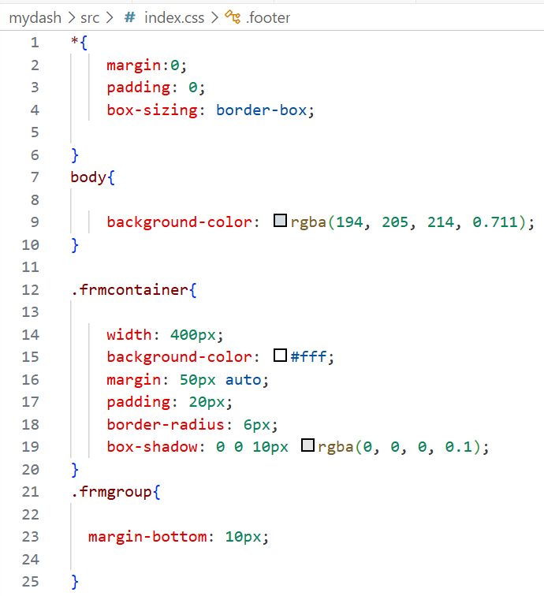
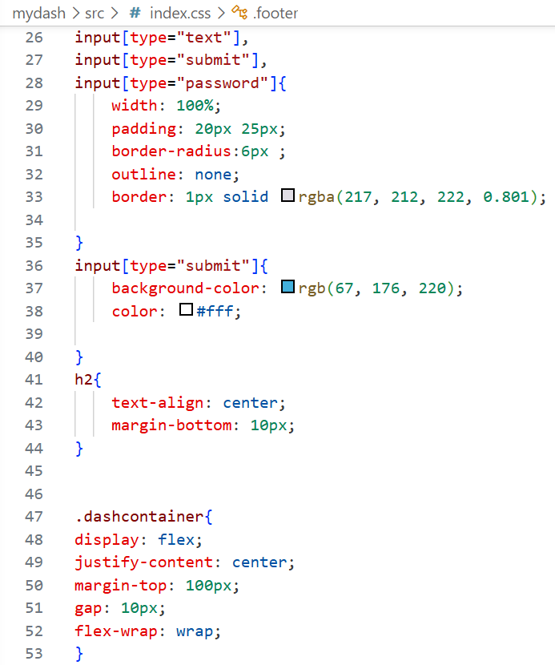

Slide 48
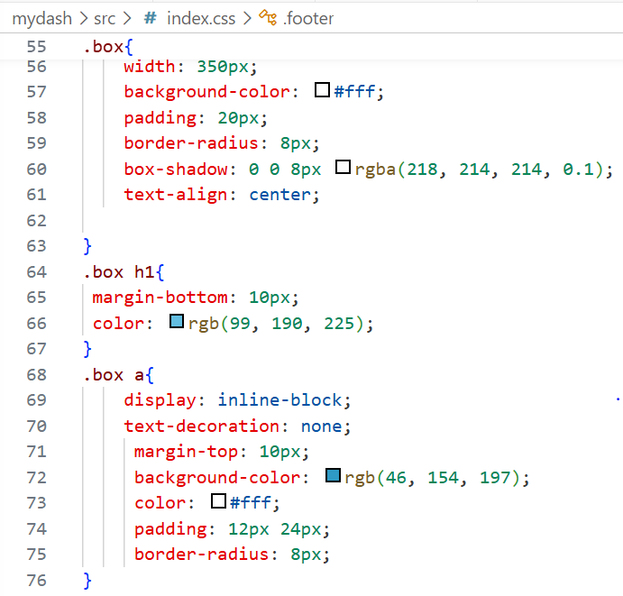
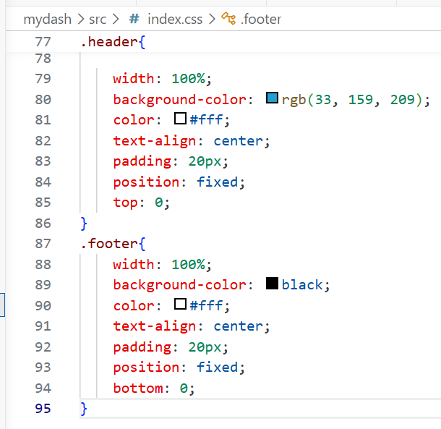

Slide 49
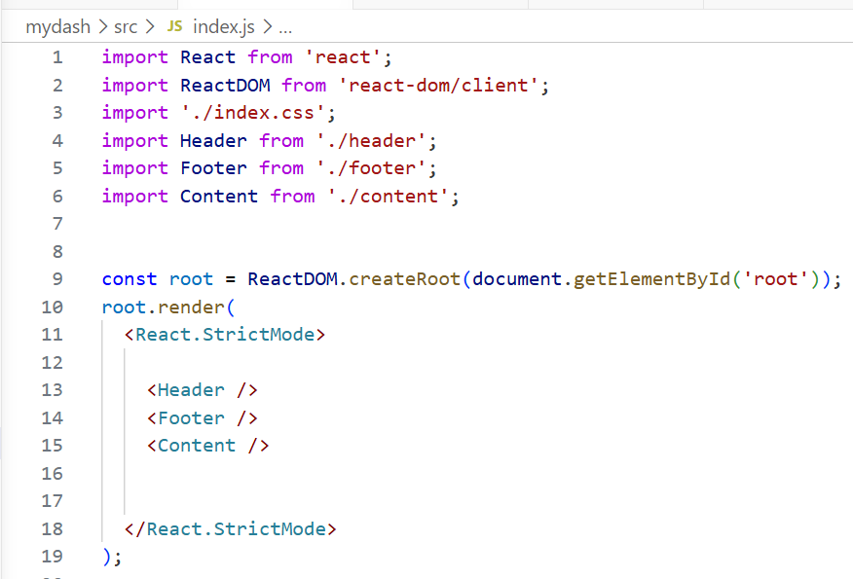
All created components are imported and rendered in index.js, which then passes them to index.html for display on the user interface. >>>>>>>>>>>>>

Slide 50
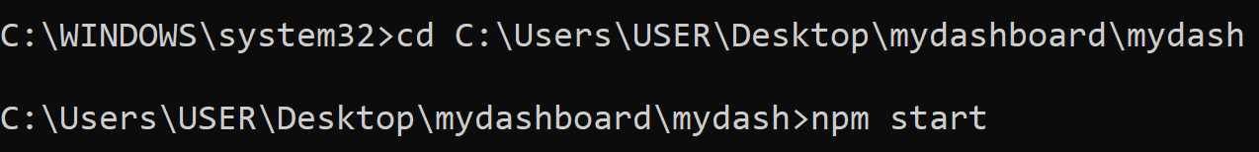
In React, component function names should start with a capital letter. This helps React distinguish between HTML tags and custom components.
Remember to run your React project folder using Command Prompt (CMD), as shown below:

Slide 51
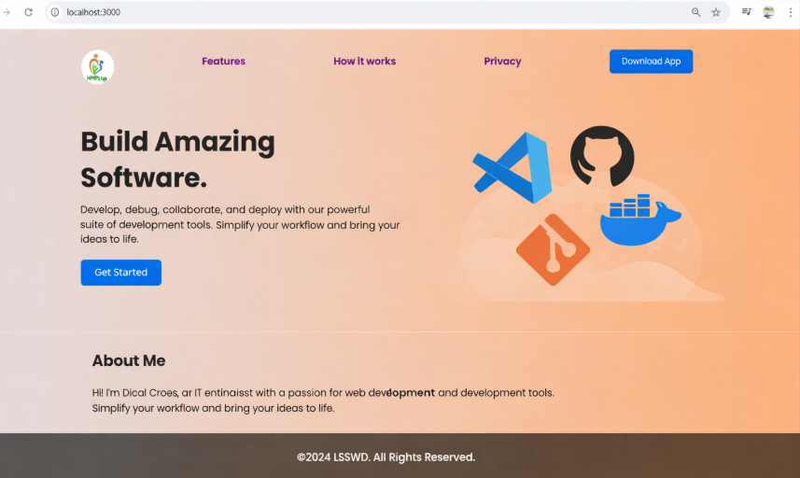
Task1: Let’s build this interface using React functional components. Focus on creating three main parts: a Header, a Content section, and a Footer. >>>>>>>>>>>>>

Slide 52
END OF CHAP 5

